Slide 1
Tutorial: Bagging and RF
Zhuangzhuang

Slide 2
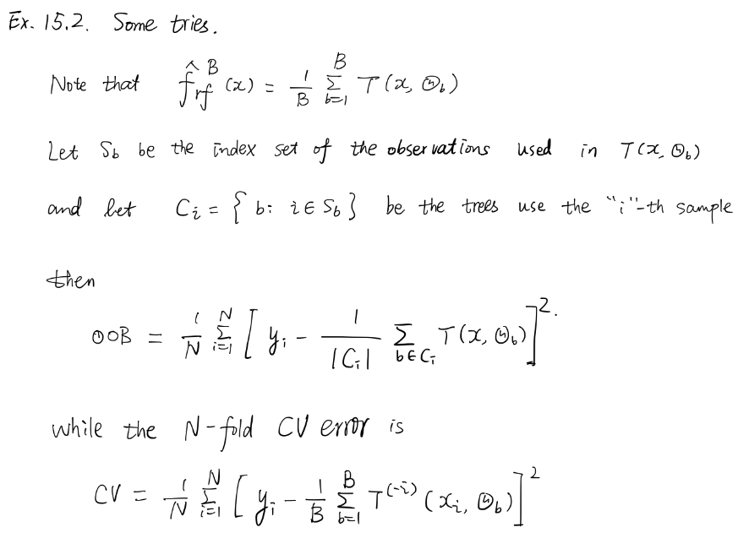
HW2
“Show that as the number of bootstrap samples B gets large, the oob error estimate for a random forest approaches its N-fold CV error estimate, and that in the limit, the identity is exact.”
Solution: https://github.com/szcf-weiya/ESL-CN/issues/21

Slide 3
HW3 (open question)
“Design a simulation to show that bagging does not work effectively for linear models, for instance, regression.”
QuantStart (well-structured python code)
Using Cross-Validation to Optimise a Machine Learning Method - The Regression Setting | QuantStart (a must-read)
Bootstrap Aggregation, Random Forests and Boosted Trees | QuantStart (sklearn)
Training the Perceptron with Scikit-Learn and TensorFlow | QuantStart (TensorFlow)

Slide 4
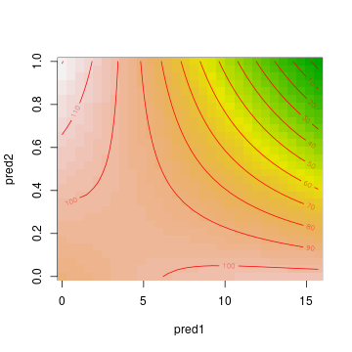
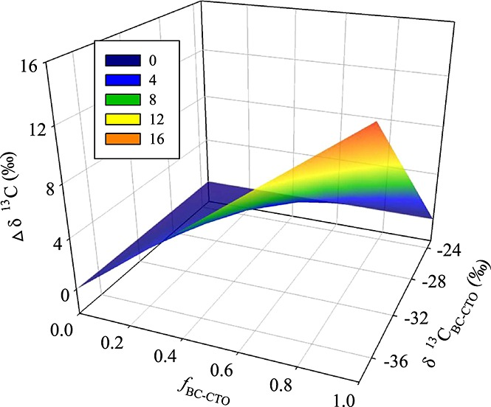
Bonus: Tree Models on Interaction
When X (feature space) is continuous,

Slide 5
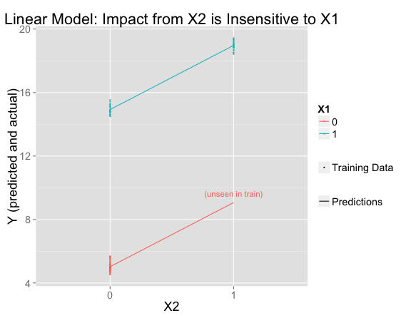
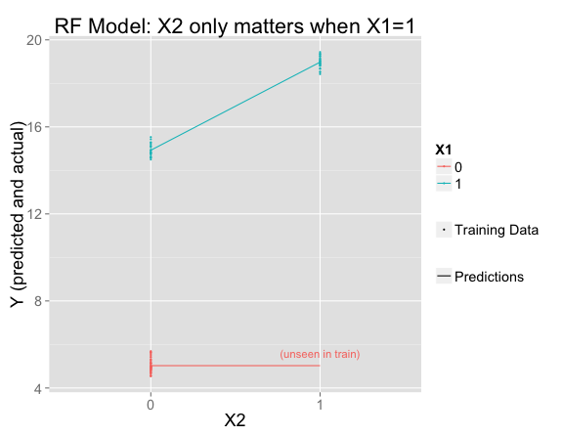
Bonus: Tree Models on Interaction
When X (feature space) is categorical (reference: An Interaction or Not? How a few ML Models Generalize to New Data – David Chudzicki)

Slide 6
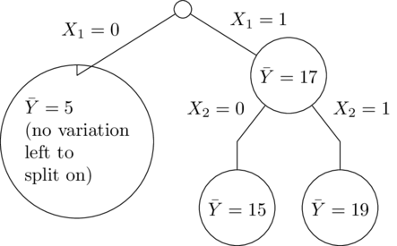
Bonus: Tree Models on Interaction
When X (feature space) is categorical (reference: An Interaction or Not? How a few ML Models Generalize to New Data – David Chudzicki)

